Slide 1
Posibilities for mobilities abroad
For PhD students

Slide 2
Contact for administraiton
Petra Zákoutská (Dpt. International relations)
  Petra.zakoutska@pedf.cuni.cz
  Monitoring of stays aborad, Erasmus, Mobility Fund, POINT,…
PhDr. Iva Beránková (Dpt. International relations)
  Iva.berankova@pedf.cuni.cz
  Administration of travel documentation for employees, GAUK holders…
Mgr. Ivana Metelková (Dpt. For research)
  Ivana.metelkova@pedf.cuni.cz
  GAUK, GAČR, TAČR, SYLF, research grants

Slide 3
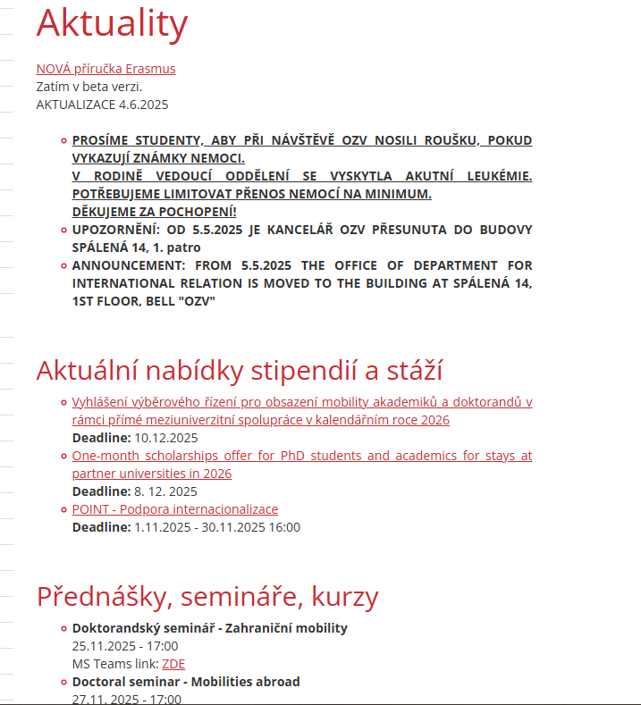
OZV NEWS https://pedf.cuni.cz/PEDF-393.html

Slide 4
Necessary steps for the stay abroad to be recognized as a fullfillment of study plan
Before departure (at least a day prior)
  Registration of stay abroad in SIS
    Necessary to attach two supporting documents
        Official Letter of Invitation
        Thesis supervisor´s agreement with the stay (can be an email)
After return
  Submitting a form of „Confirmation of stay“ (email)
    Any form of the document is accepted
    Plain document can be found on website - https://pedf.cuni.cz/PEDF-2654.html

Slide 5
Important notice
The Department for international relations is responsible for only monitoring the stays abroad
  We are not qualified to determine whether your chosen internship is suitable or long enough
  This is the responsibility of your thesis supervisor and/or the Field of Study committee
From the academic year 2025/2026 ALL study related stays abroad, regardless of whether they are a fulfilment of a study plan, should be registered in the Internship folder in SIS
You do not need to receive a form of monetary support from the Faculty of Education for your stay to be recognized as fulfilment of your study duties

Slide 6
Erasmus+
Possible to travel to every country in European Union
Call for applications only once a year in spring for the next academic year
Stipend has two parts – living expenses + travel allowance
  Living expenses – fixed monthly/daily rate
  Travel allowance – depends on the distance and method of travel
Student can participate multiple times
  Given limited budget, in case of large interest in a call the priority is given to those who have not participated yet
  More information here -> https://cuni.cz/UKEN-2360.html
  Faculty of Education has specific rules
    Call of applications only once a year
    For semester/full year stay you need to use only agreements of your department

Slide 7
Erasmus + Types of mobilities
Study stay – a semester or two
  Your department needs to have an active bilateral agreement
Traineeship – a semester or two
  Practical placement, necessary 40 hours a week minimum
PhD Short term stay – 5 to 30 days

Slide 8
Erasmus + PhD short term mobility
Stay for 5-30 days
Monetary support is higher for the first 14 days
Students find a suitable placement themselves
  Has to be an instituion with official registration number of an institution
  Students are responsible to find out if the institution is able to accept them through this specific type of mobility
Call for applications once a year in spring
  Students need at least a written promise of being accepted, ideally an invitation letter

Slide 9
Mobility Fund
Financing for mobilities everywhere in the world
Type of mobilites
  For a semester or two
  participation in international academic or professional events of students abroad, short-term scientific or research stays abroad
Stipend between 10-15 000CZK/month (Europe), 15-20 000CZK (world)
Call for applications in IS Věda (https://is.cuni.cz/veda/portal/dashboard )
  February – March, September – October (Need to follow faculty deadline)
  More information -> https://cuni.cz/UKEN-927.html

Slide 10
Internationalisation - POINT
Financing for mobilities everywhere in the world
Lenght of mobilites up to 3 weeks
  participation or mobility of CU students to summer schools (with the exception of language stays), short-term unpaid professional student internships, international competitions and championships, student conferences with active participation, representation of the CU at an international plenary related to the internationalization of the University's activities
Maximum stipend is 25 000CZK
Call for applications in IS Věda (https://is.cuni.cz/veda/portal/dashboard )
  April and November
More information here -> https://cuni.cz/UKEN-924.html

Slide 11
Interinstitutional Agreements
CU degree students can spend a semester or a full academic year abroad without paying tuition fees
Some agreements also offer opportunities for internships, research stays, language courses, and winter/summer schools
Calls multiple times a year
  Always in Aktuality ->https://pedf.cuni.cz/PEDF-393.html

Slide 12
Aktion
For mobilities into Austria
Lenght of stay 1-5 months
Purpose of the stay is a reaserch and consultations that lead to finishing a thesis
Stipend 1300Eur/month
Call for application: March + October
More info -> https://www.dzs.cz/en/program/aktion-austria-czech-republic/foreign-exchange-stays

Slide 13
Barrande fellowship
Mobilities to France
Consultations usually in French, usually harder to find a consultat who is willing to consult in English
1-3 month stay, stipend of 1 704 EUR/month
Call for application: January
More information ->https://www.dzs.cz/en/program/barrande-fellowship-programme/foreign-exchange-stays

Slide 14
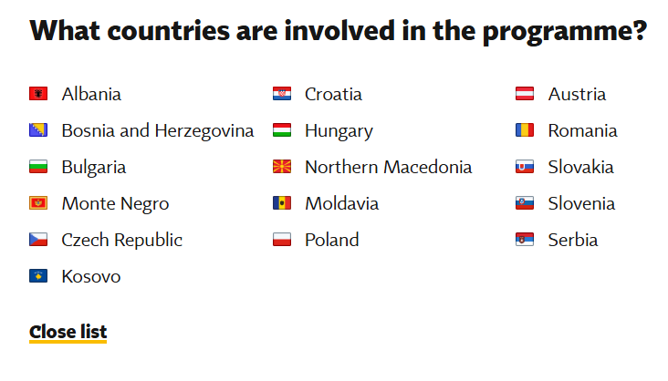
CEEPUS
  Central European Exchange Programme for University Studies
Financing of mobilities to participating countries
short-term stay
  lasting for 1-2 months, for the purpose of preparing a thesis
a semester long stay
  lasting for 3-10 months
Calls for mobilites vary
More information here -> https://www.dzs.cz/en/program/ceepus/foreign-exchange-stays

Slide 15
Stipend programme SYLFF
For social sciences or humanities students with leadership potential
  An important criterion for supporting specific research is its contribution to society
Please note: it is mandatory to complete your dissertation or a substantial part of it during the duration of the stipend.
  Stipend awarded: 12 500 USD/year, includes a study visit abroad
Conditions:
  At the time of applying, the student must be a full-time PhD student (maximum 3rd year) of the full time degree (not combination)
  Must study at one of these CU faculties: Faculty of Arts / Faculty of Social Sciences / Faculty of Humanities / Faculty of Law / Faculty of Education / Hussite Theological Faculty / Protestant Theological Faculty / Catholic Theological Faculty
Deadline for application:
Tends to ne the end of April, collected by faculty coordinators (Mrs. Metelková)
More information can be found -> https://cuni.cz/UKEN-2354.html

Slide 16
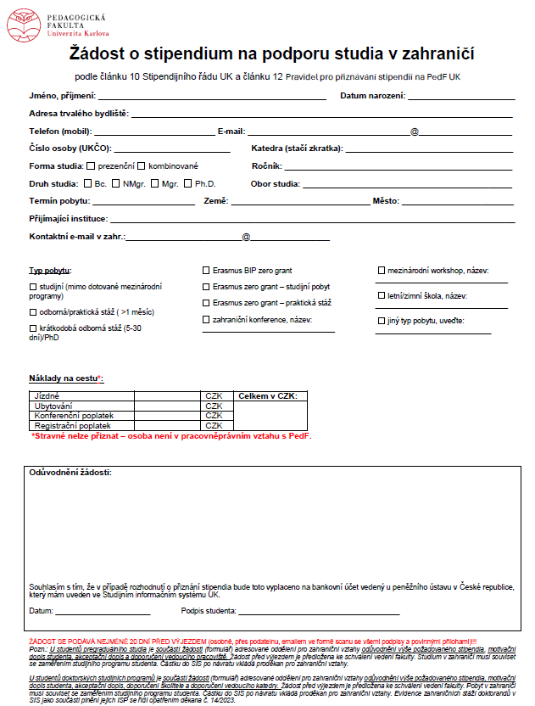
Faculty Stipend
Should be your last option
A limited budget for ALL students of the Faculty of Education
The form is available at your department or upon request from dept. For international Relations
Letter of Motivation is a mandatory attachment
Must be handed in at least a month in advance!
SAMPLE

Slide 17
For More information head here
The complete list of stipend programmes and other possibilities can be found on the CU website
Charles Abroad shares information about stipends, mobility opportunities and other generous offers in the section “opportunities” on their website, where you can opt to sign into their newsletter based on your study cycle and study area
  Best offers are shared on the Charles Abroad Instagram, where you can also read about the experiences of other students
We also recommend you keep an eye on the website of the Czech National Agency for International Education and Research and sign into their newsletter

